Slide 1
Small Project 3
Testing API web OrangeHRM with Postman

Slide 2
01
Using windows 11
Postaman
Google chorme 99.0.4844.74
Network wifi
Github

Slide 3
Goals
User Can do Automation Testing Api web OrangeHRM without any problem

Slide 4
Featurs test
On Postman
Admin : 1.Create Token
2.Login
3.Get User
4.Organization
Attendance 1.Punch in
2.Punch Out
Emmploye 1.save employe
2.employee education
3.employee work experience
4.contact detail employee
5.employee dependants
6.employee jobs detail
7.supervisor employee

Slide 5
Negative Test Case
On Postman
Login with wrong data : As expected
Attandance punch in with wrong timezone : As expected
Attandance punch out with wrong datetime : As expected

Slide 6
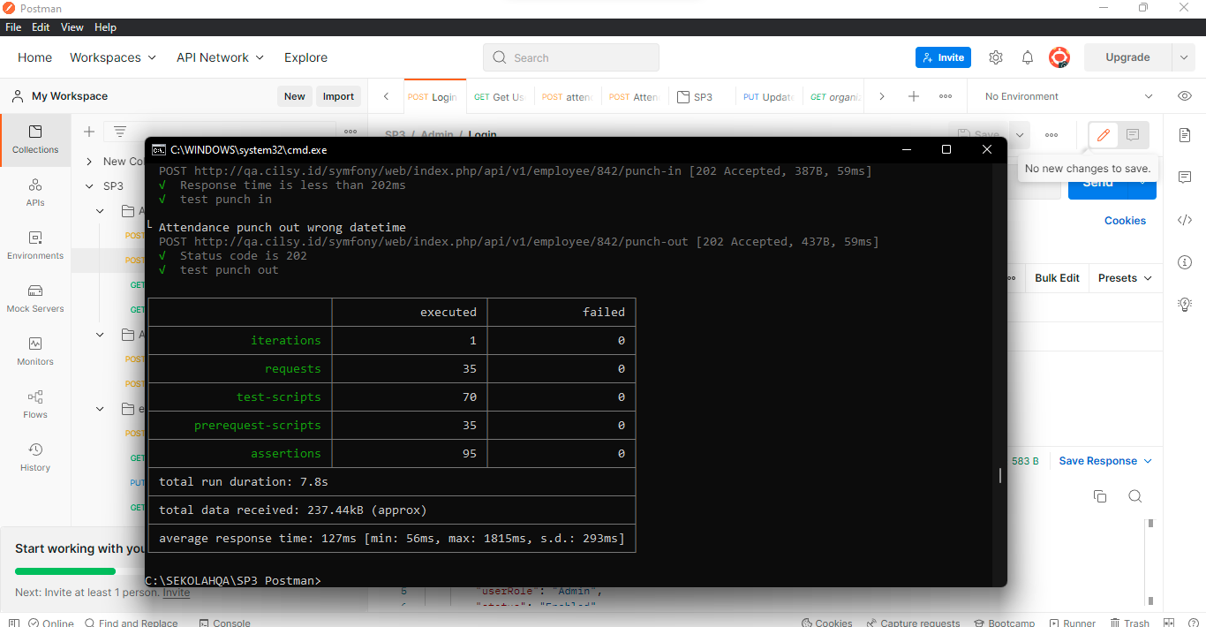
Test Report
On Newman Postman

Slide 7
Shopping cart
User go to https://demo.midtrans.com/ and then user can click buy, showing shopping cart Side Bar, user can input list customer detail

Slide 8
OrderSummary
User can see pop up order summary and see list personal data att shipping details and amout details

Slide 9
Payment method
User can see pop up payment method and can choose payment user want

Slide 10
Payment Credit card with promo and without method
User can see pop Credit Card method and user can input text creditcard Number, user can see promo method and user can use or not promo method, user success full credit card method with promo or without promo

Slide 11
Payment Credit card with Wrong Number
User can see pop Credit Card method and user can input text creditcard Number, but if user put wrong credit card number, on credit card pop up showing text invalid card number

Slide 12
Payment Credit card with Wrong Number
User can see pop Credit Card method and user can input text creditcard Number, but if user put wrong credit card number, on credit card pop up showing text Process failed. Re-check your card details or use another card.

Slide 13
Payment Credit card with Denied Card Number
User can see pop Credit Card method and user can input text creditcard Number, but if user put Denied credit card number, on the next step at PopUp Issuing Bank at the next step user can find text transaction failed

Slide 14
Payment Credit card with Blank Card number
User can see pop Credit Card method and user not input Credit card Number, at coloms credit card number text will turn red

Slide 15
Payment Credit card with Voucher invalid
User can see pop Credit Card method and User can input credit card number at coloms credit card, user click voucher not available to payment with credit cart, user can see Pop up Promo is not Available at Credit card payment method

Slide 16
Payment TransferBank
User can see pop List TransferBank and user can choose bank to be transferd payment, and user can showing pop up selected bank and showing list payment method payment bank and then user can see list how to transfer and see account number to be transferd and user can click please complement payment and showing pop up we’ve booked your payment

Slide 17
Payment clik BCA
User can see pop List clik BCA, user can input user id clik BCA and user click button payment now showing pop up complete payment clik BCA and showing pop up we’ve booked your payment

Slide 18
Payment with blank user id clik BCA
User can see pop List clik BCA, user not input user id click BCA and user click button pay now at payment click BCA showing red box at coloms user id BCA

Slide 19
Payment with wrong/ number maximun user id clik BCA
User can see pop List clik BCA, user input worng number/maximum number at user id click BCA and user click button pay now showing pop up error payment data is invalid

Slide 20
Payment UOB EZ PAY WEB
User click payment UOB EZ PAY and showing pop up list UOB EZ PAY Transfer, user can click Payment WEB and showing pop up list UOB EZ PAY WEB and user can click paynow, user go to web payment midtrans UOB EZ PAY showing detail transaksi and click bayar showing pop up transaksi sukses and click websait merchaint, user go to web midtrans

Slide 21
Payment UOB EZ PAY TMRW APP
User click payment UOB EZ PAY and showing pop up list UOB EZ PAY Transfer, user can click Payment TMRW APP and showing pop up list UOB EZ PAY TMRW and user can click paynow, user go to web payment midtrans UOB EZ PAY showing detail transaksi and click bayar showing pop up transaksi sukses and click websait merchaint, user go to web midtrans

